Slide 1
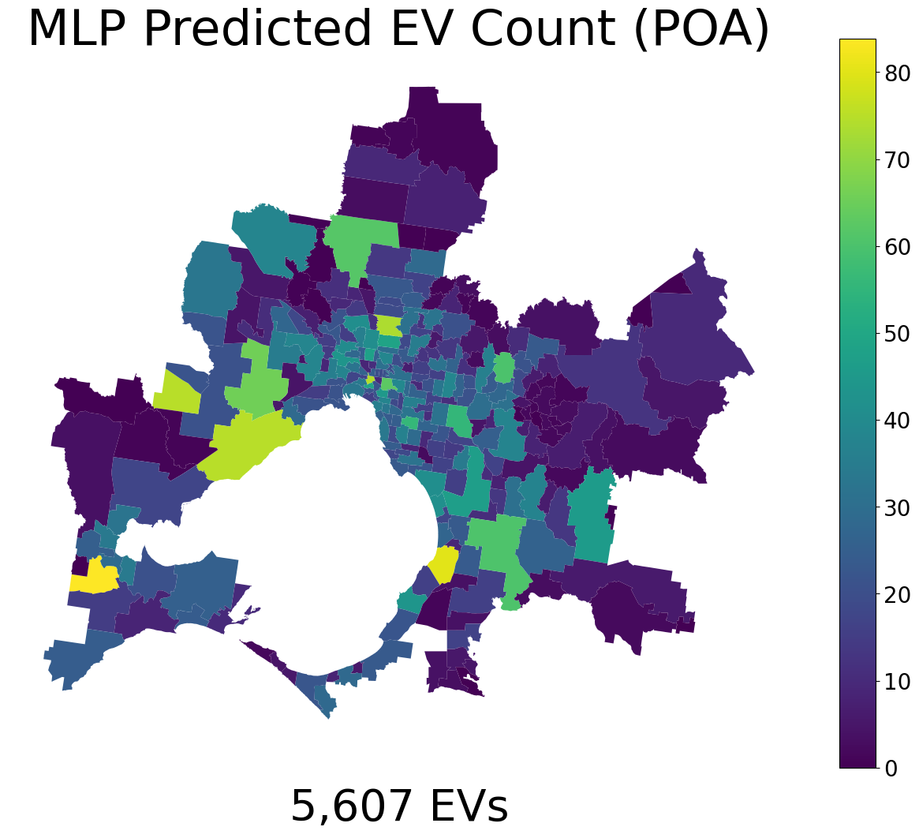
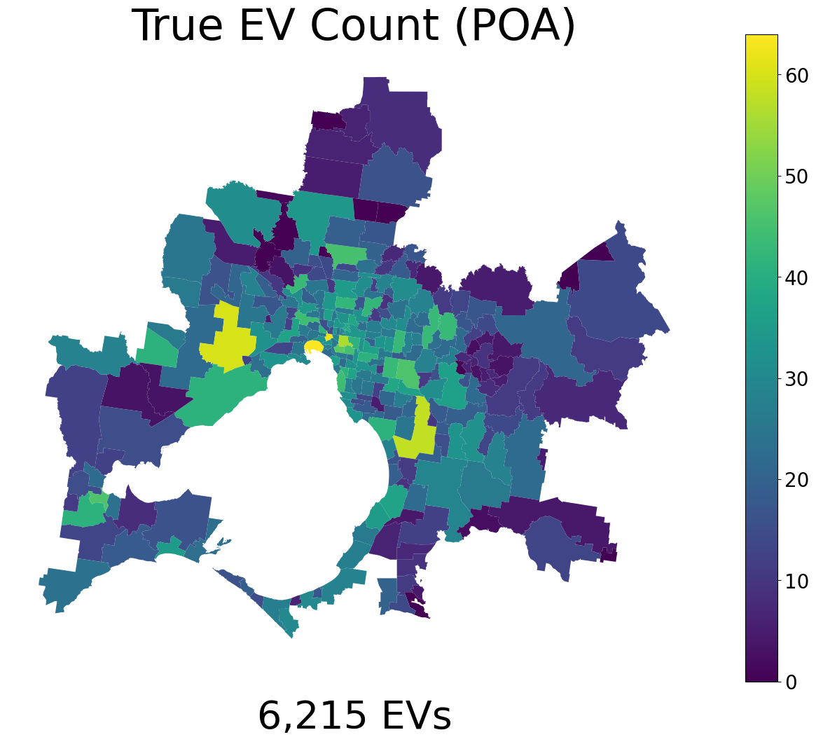
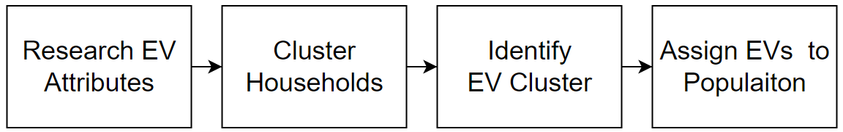

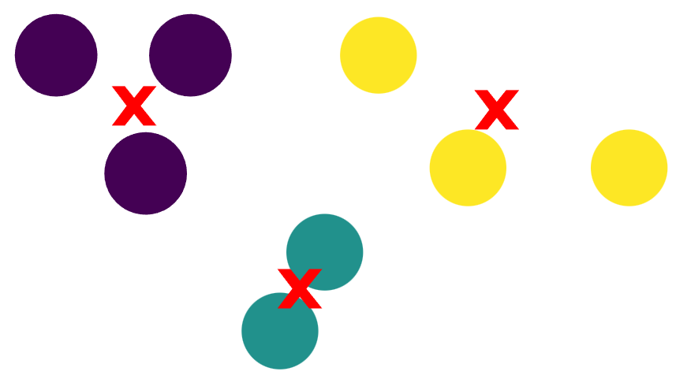
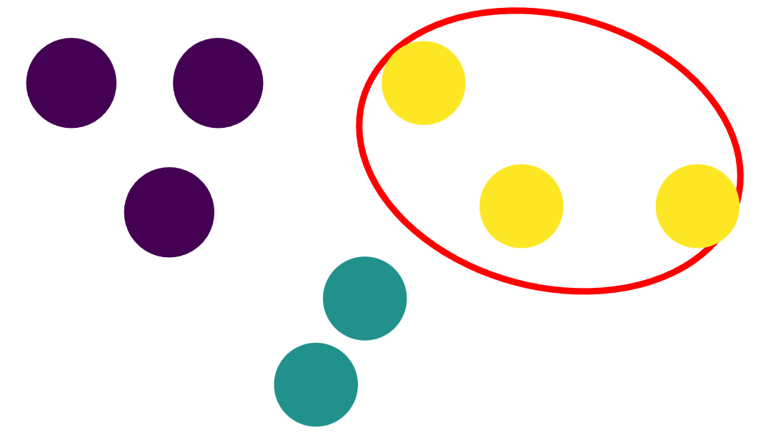
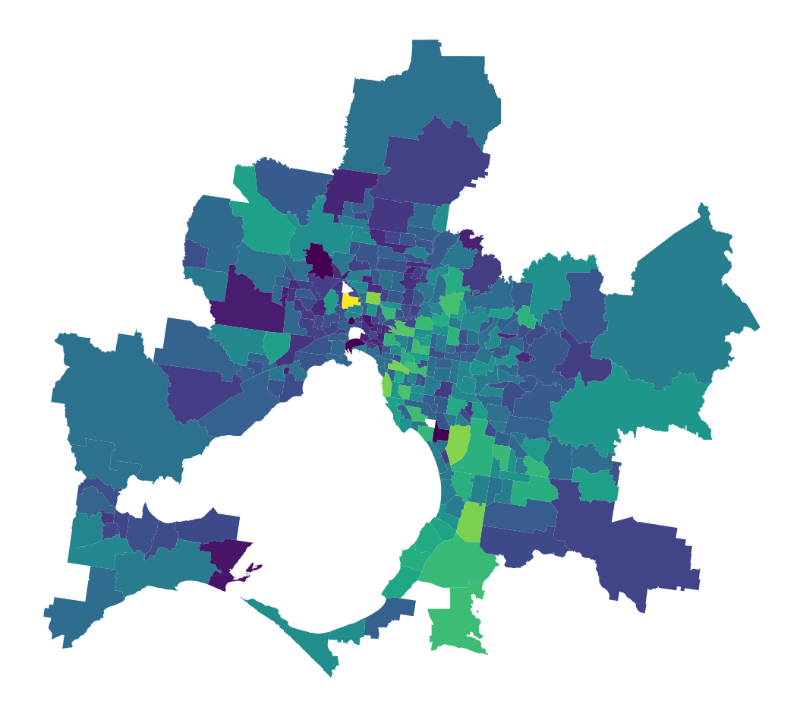
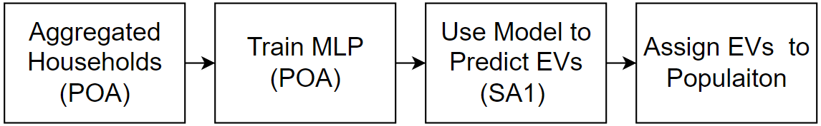
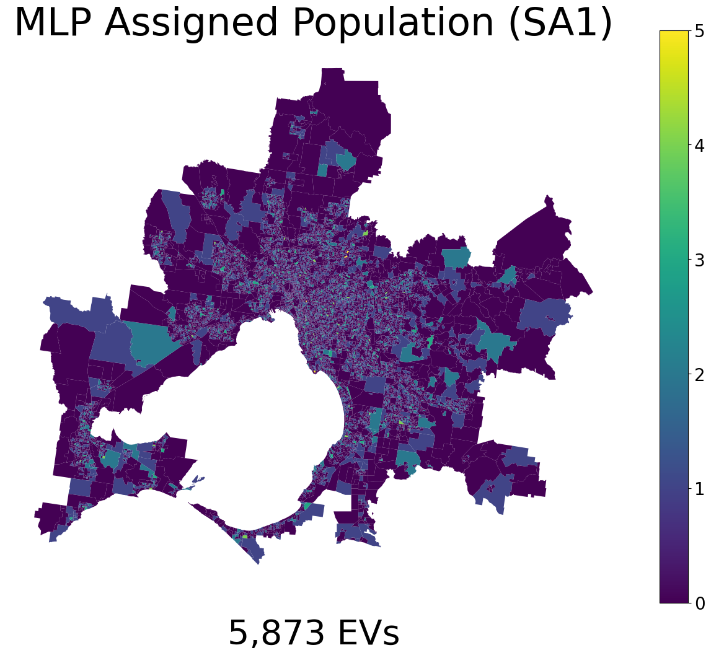
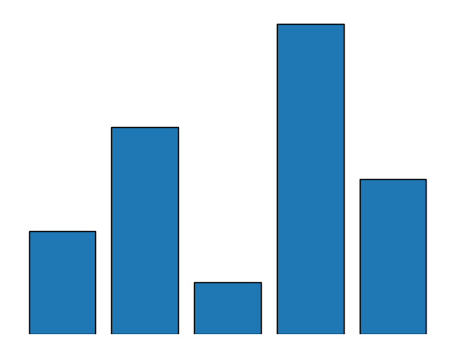
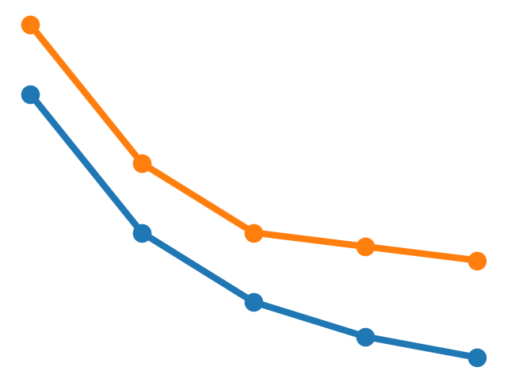

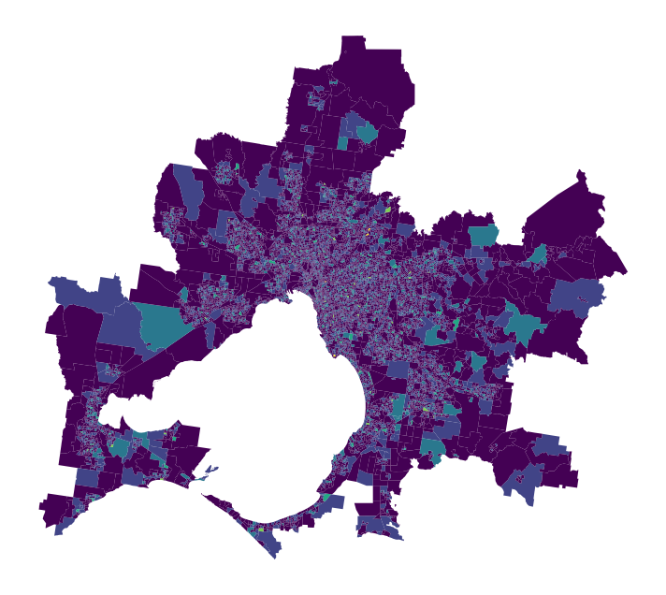
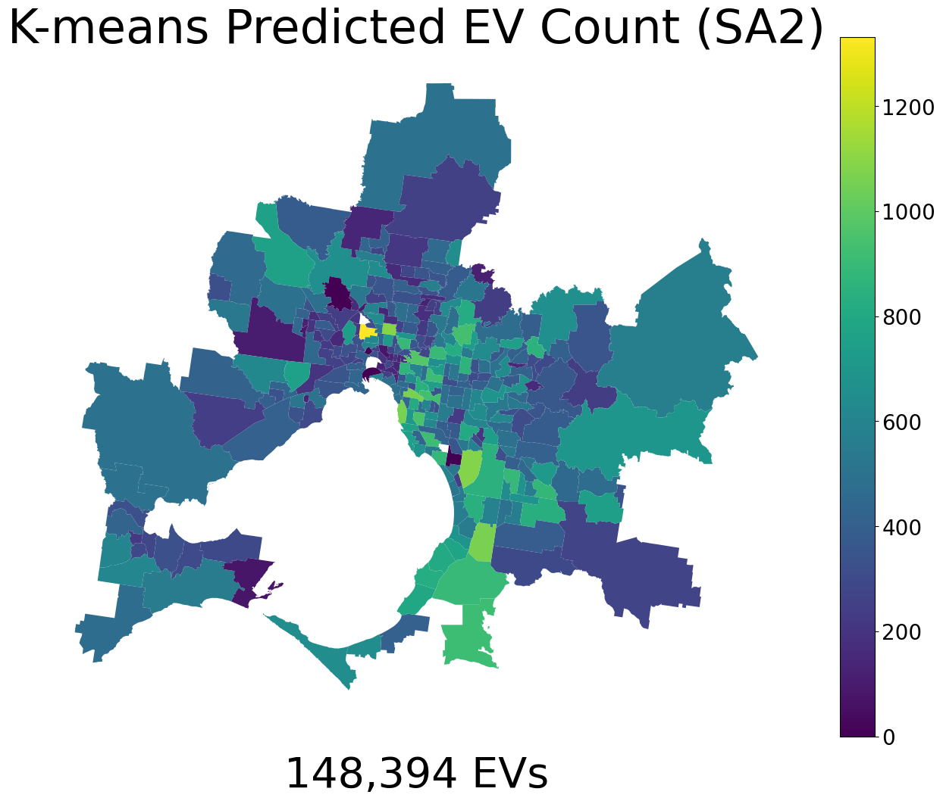
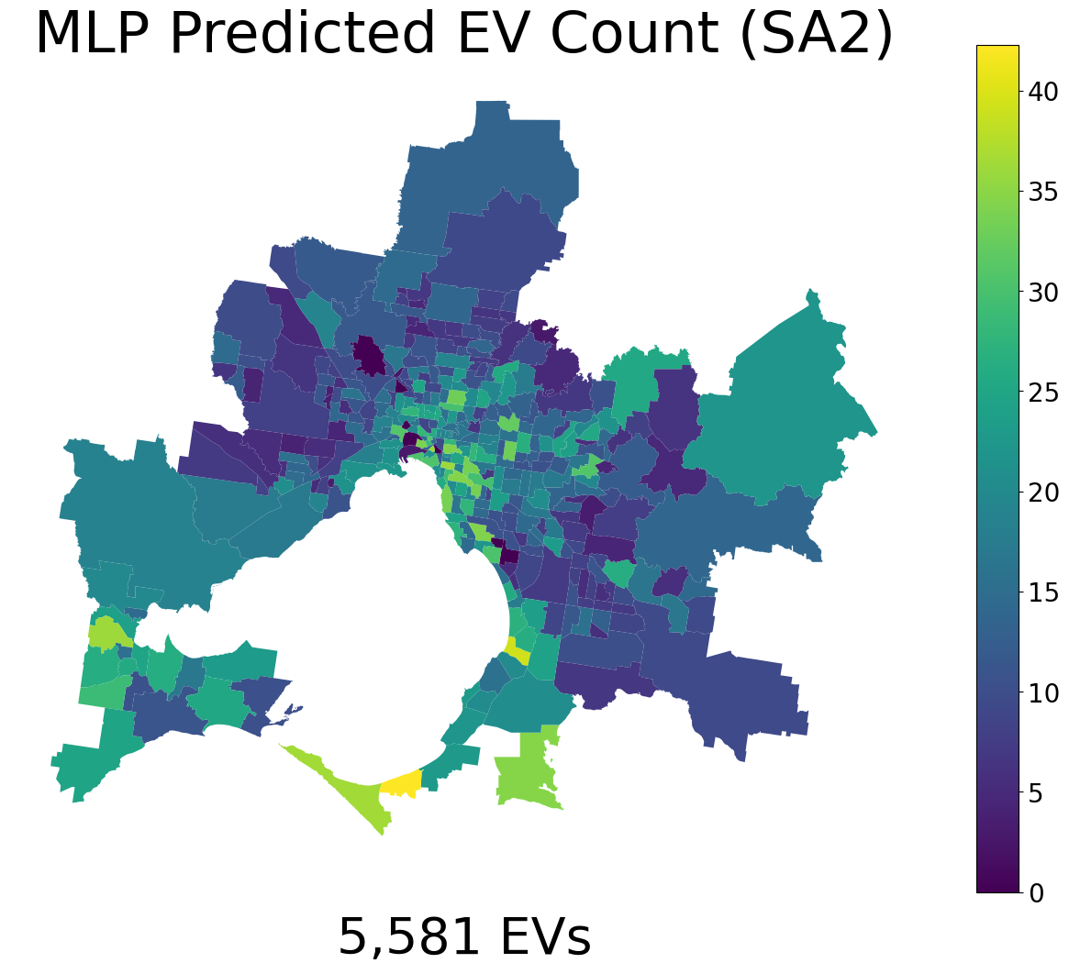
Modelling Electric Vehicle Ownership in Melbourne and Geelong
Daniel Lawson
Supervised by:
Professor Le Hai Vu
Duc Minh La
Introduction
Currently we are living through the electric vehicle (EV) revolution [1]. The growth in EV adoption can be attributed to: • environmental concerns • improved EV technology • more EV options. Understanding the present and future state of EVs is important to policy makers. They are tasked with facilitating a smooth transition to electrification and must understand where and what EV infrastructure is to be built [3].
Project Aims: to inform policy makers about who owns EVs and where EV owners live. Given the rapid evolution of the EV sector, coupled with variations between countries and cities, existing EV research does not capture the region-specific nuances of EV ownership [4].
Outcome: will assign EV ownership status to a synthetic population of Melbourne/Geelong based on • household attributes • household location
METHODS AND MATERIALS
Two methods have been developed to generate an assign EV population. One that predicts EV ownership based on household attributes alone and the other incorporates EV data.
Method 1: Synthetic population ✔ - EVs data ✘
Method 2: Synthetic population ✔ - EVs data ✔
RESULTS AND DISCUSSION
Method 1:
Successfully identified a cluster of the population that had attributes strongly associated with EV ownership. K-means was chosen due to its run-time efficiency and consistency in segmenting households. The assigned synthetic population generated is shown below.
Evs predicted at SA2: 148,305
True number of EVs: 6,128.
Over prediction by a factor of 24.2
The over prediction highlights a key limitation of estimating EV ownership without knowing the total number of EVs. To improve this method more clusters needed to be produces, which would effectively reduce the size of the EV cluster.
Predictions accounts for 4.7% of vehicles in Melbourne/Geelong
Given Norway’s EV sales account for 72% of new car sales [1], the model's prediction is not unrealistic if it is interpreted as a prediction of who has the means to own an EV in the future.
Method 2:
Figure 3: MLP EV Prediction
Figure 4. True Number of EVs
Method 2: Test Loss 7.57 MAE. Training/ Validation Loss ≈ 9.46 MAE
EV prediction at POA: 5,607. Error ≈ 10%.
EV prediction at SA1: 5,897. Error ≈ 5%.
The POA accuracy is important in validating the prediction made at SA1 level.
Most EVs assigned to a SA1: 5.82 (In Melbourne’s CBD)
The assigned EV population was then validated by previous literature. All attributes were supported partially or fully.
Table 1. EV Population Attributes
 | Mean | Literature Support
Income | $1,828 | Semi
Total Vehicles | 2.6 | ✔
Household Size | 6.15 | ✔
Separate House | 81.28% | ✔
Purchasing/ Fully Owned | 66.37% | ✔
Figure 5. True number of EVs
CONCLUSIONS
Project successfully:
predicted the household attributes of EV owners in Melbourne/Geelong
pinpointed their location down to the SA1 level.
predict at various geospatial scales
Because of its accuracy method 2 can be used by policymakers to inform:
Best locations for EV infrastructure
EV inceptive based on household attributes
Method 1 fell short in predicting an accurate number of EVs; however, it offers a valuable framework to estimate EV ownership in the absence of EV data.
Method 2 emerged as the preferred method as it is more robust and can utilize real world data.
References
3. Department Energy, 2023
4. Hjorthol, R. Institute of Transport Economics, 2013.
Figure 1: Method 1 Predicted EVs
Figure 2: Method 2 Predicted EVs
Electric Vehicle Council, 2023.
LaMonaca, S. and L. Ryan, 2022.
2023-[CL_CIV-237]

